Slide 1
Routing Strategies
Fixed Routing
  A route is selected for each source-destination pair of nodes in the network
  No difference between routing for datagrams and virtual circuits
  Simplicity, but lack of flexibility
  Refinement: supply the nodes with an alternate next node for each destination

Slide 2
Routing Strategies (cont)
Flooding
  A packet is sent by a source node to every one of its neighbors
  At each node, an incoming packet is retx on all outgoing link except for the link on which it arrived
  Hop count field deals with duplicate copies of a pkt
  Properties
    All possible routes btw source and destination are tried
    At least one copy of the packet to arrive at the destination will have a minimum-hop route
    All nodes connected to the source node are visited

Slide 3
Routing Strategies (cont)
Random Routing
  Selects only one outgoing path for retx of an incoming packet
  Assign a probability to each outgoing link and to select the link based on that probability
Adaptive Routing
  Routing decisions that are made change as conditions on the network change
    Failure
    Congestion

Slide 4
Routing Strategies (cont)
Adaptive Routing
  State of the network must be exchanged among the nodes
  Routing decision is more complex
  Introduces traffic of state information to the network
  Reacting too quickly will cause congestion-producing oscillation
  If it reacts too slowly, the strategy will be irrelevant

Slide 5
Shortest Path Algorithm
Dijkstra’s Algorithm
Bellman-Ford Algorithm
8
5
3
2
3
5
6
2
8
6
3
3
1
2
2
3
1
4
1
1
2
7
1
4
5
1

Slide 6
Reduced graph
5
3
2
3
5
2
6
1
2
3
1
2
1
4
5
1

Slide 7
Dijkstra’s Algorithm
2
3
2
3
1
D₂ = 2
D₃ = 5
D₂ = 2
D₃ = 4
6
1
6
4
5
4
5
D₄ = 1
D₄ = 1
D₅ = 2
M = { 1 }
M = { 1, 4 }
2
3
D₃ = 3
2
3
D₂ = 2
D₂ = 2
D₃ = 4
1
6
1
6
4
5
D₆ = 4
4
5
D₄ = 1
D₅ = 2
D₄ = 1
D₅ = 2
M = { 1, 2, 4, 5 }
M = { 1, 2, 4 }

Slide 8
Dijkstra’s Algorithm (cont)
Node
D
M
2
3
4
5
6
1
2
5
1
∞
∞
1, 4
2
4
1
2
∞
1, 4, 2
2
4
1
2
∞
1, 4, 2, 5
2
3
1
2
4
1, 4, 2, 5, 3
2
3
1
2
4
1, 4, 2, 5, 3, 6
2
3
1
2
4

Slide 9
Dijkstra’s Algorithm (cont)
w(i, j) = link cost, L(n) = path cost from node s to n
1. [Initialization]
  T = {s}
  L(n) = w (s, n) for n ≠ s
2. [Get next node]
  Find x ∉ T such that L(x) = min L(j)
  Add x to T
3. [Update Least-Cost Paths]
  L(n) = min [ L(n), L(x)+w(x, n) ] for all n ∉ T
  Go to step 2
j∉T

Slide 10
Bellman-Ford Algorithm
D⁽²⁾₃ = 4
2
3
2
3
1
D⁽¹⁾₂ = 2
D⁽¹⁾₃ = 5
1
D⁽²⁾₂ = 2
6
6
4
5
4
5
D⁽²⁾₆ = 10
D⁽¹⁾₄ = 1
D⁽²⁾₄ = 1
D⁽²⁾₅ = 2
h = 1
h = 2
D⁽³⁾₃ = 3
2
3
1
D⁽³⁾₂ = 2
6
4
5
D⁽³⁾₆ = 4
D⁽³⁾₄ = 1
D⁽³⁾₅ = 2
h = 3

Slide 11
Bellman-Ford Algorithm (cont)
Node
D
h
2
3
4
5
6
Source = 1
0
∞
∞
∞
∞
∞
1
2
5
1
∞
∞
2
2
4
1
2
10
3
2
3
1
2
4
4
2
3
1
2
4

Slide 12
Bellman-Ford Algorithm (cont)
L_{h}(n) = path cost from s to n w/ no more than h links
1. [Initialization]
  L₀(n) = ∞, for all n ≠ s
  L_{h}(s) = 0, for all h
2. [Update]
  For each successive h ≥ 0
  For each n ≠ s, compute
  L_{h+1}(n) = min [ L_{h}(j) + w(j, n) ]
link
s
j
n
<= h links
j

Slide 13
Comparisons
L(n) = min [ L(n), L(x)+w(x, n) ]
L_{h}(x, D)
x
…
……
S
D
S
x
D
x
Dijkstra’s
(Link State)
Bellman-Ford
(Distance Vector)

Slide 14
Routing in ARPANET
First generation(RIP), 1969
  Adaptive Routing is adopted
  Use Bellman-Ford algorithm
  Estimated link delay is simply the queue length for that link
  Every 128ms, each node exchanges its delay vector(routing table) with all its neighbors
  Information about a change in network condition would gradually ripple through the network

Slide 15
Routing in ARPANET (cont)
  Each node i maintains
    d_{i j} = current estimate of min delay from i to j
    s_{i j} = next node in the current min-delay route from i to j
  Node k updates its vectors as follows
    d_{k j} = Min [ l_{k i} + d_{i j} ]
    i ∈ A
    s_{k j} = i using i that minimizes the expression above
    where
    A = set of neighbor nodes for k
    l_{k i} = current estimate of delay from k to i
k
i
j

Slide 16
Routing in ARPANET (cont)
Major shortcomings of RIP
  It did not consider line speed, merely queue length. Higher capacity links were not given the favored status
  Queue length is an artificial measure of delay
  The algorithm was not very accurate. It responded slowly to congestion and delay increases.

Slide 17
Routing in ARPANET (cont)
Second generation, 1979
  OSPF: Open Shortest Path First protocol
  Link-state routing protocol
  The delay is measured directly
  Every 10 seconds, the node computes the average delay on each outgoing link
  Information of changes in delay is sent to all others nodes using flooding
  Using Dijkstra’s algorithm

Slide 18
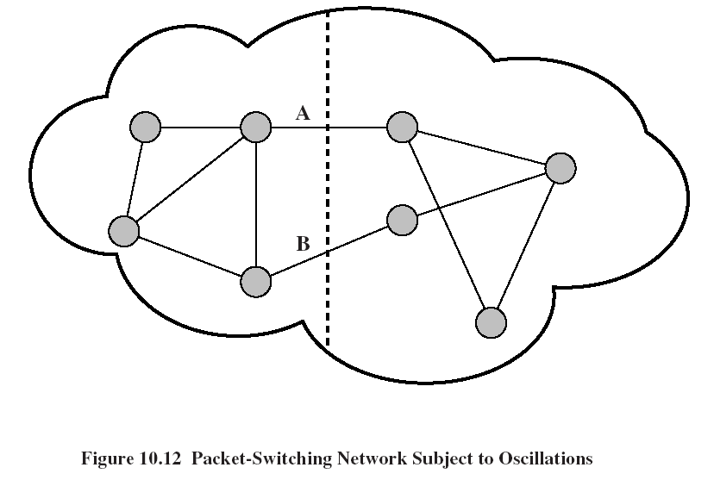
Routing in ARPANET (cont)

Slide 19
Routing in ARPANET (cont)
Third generation, 1987
  Problem
    The correlation between the reported values (delay) and those actually experienced after rerouting
  Conclusion
    Under heavy load, the goal of routing should be to give the average route a good path instead of attempting to give all routes the best path
  Solution
    Also consider the average utilization of links
    Revised cost function: delay-based metric under light loads, capacity-based metric under heavy loads

Slide 20
Calculate Link Costs
Measure the avg. delay over the last 10 sec
Using the single-server queuing model, the measured delay is transformed into an estimate of link utilization
Average the link utilization with the previous estimate of utilization
The link cost is set as a function of average utilization

Slide 21
ARPANET Delay Metrics (3rd)
5
Theoretical
queueing delay
4
Delay (hops)
3
Metric for
satellite link
2
Metric for
terrestrial link
1
0
0.0
0.1
0.2
0.3
0.4
0.5
0.6
0.7
0.8
0.9
1.0
Estimated utilization

